Slide 1

MICRO-CREDIT DEFAULTER
- Prathamesh Mistry
MODEL

Slide 2

INTRODUCTION

Slide 3

PROBLEM STATEMENT
We have collaborated with a client from the Telecom Industry that provides micro-credit on mobile-balanced (main as well as data) to its customers. The company provides micro-credit.
to the customers which is to be paid within a
period of 5 Days.
We have to build a model that will help the client to Loan-out credit to those population who will be able to pay back the Loan back within 5 Days, based of the historical data.

Slide 4

ANALYTICAL PROBLEM FRAMING
General Problem Description
The Problem is of Classification.
The Data consists of 32 features in the dataset.
There are more than 200K samples in the dataset.
All the Data is of numerical datatype.
Use various algorithms to build up the model.
The target classes are highly imbalance, imbalance must be addressed.
The target has 2 classes only, it is a binary classification problem.
As the target contains highly imbalance classes (85%-15%), we may use AUC_ROC as out primary scoring and evaluation metric.

Slide 5

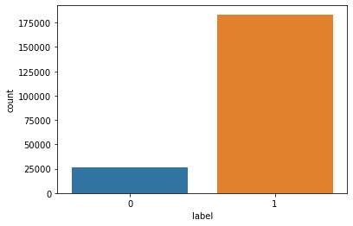


DATA IMBALANCE
We have highly imbalance target classes n the dataset.
Sales
Defaulters 13%
Non- Defaulters 87%
1st Qtr 2nd Qtr

Slide 6
DATA PRE-PROCESSING
The Data pre-processing done is as follows:
Skew transformation using Cube root Transformation.
Reducing Dimensions by removing the features with about 0 percent variance.
Reducing Dimensions by removing the features that are independent of the target
variable using ANOVA Test.
Over Sampling of the minority class using SMOTE. Increased minority class
samples by 1.5% only.
Last 0.5 Percent of Quantile stripped of some features, 2 to be exact (features had extremely high skew , about 1400 samples removed in total using quantile reduction)
Standard Scaling the data
(Note: All of the above processes are carried out strictly on the training dataset only and no test data is exposed to the model.)

Slide 7

VISUALIZATIONS

Slide 8
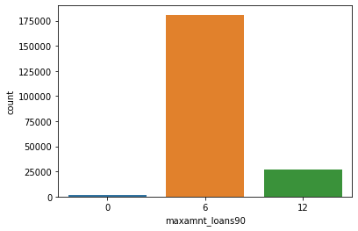
MOST POPULAR LOAN SCHEME
Most of the customers preferred the 6 Indonesian Rupiah than 12 Rupiah.
There are some samples in the dataset that haven't taken any loan yet.

Slide 9
OVER SAMPLING
As there was imbalance in the dataset , we did a 1.5% of minor class Oversampling.

Slide 10
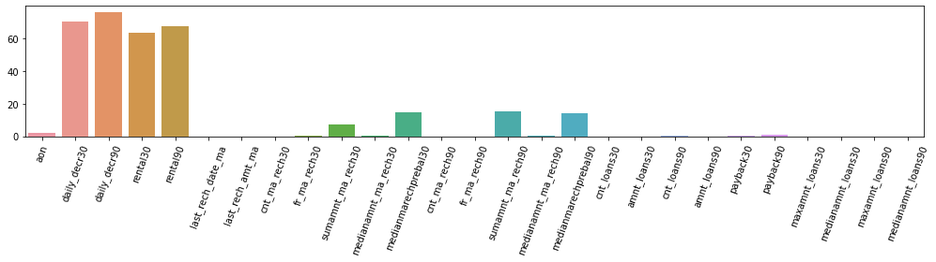
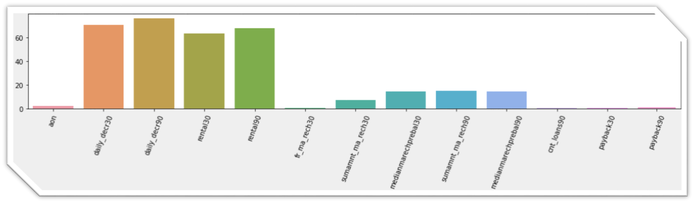
PROMINENT FEATURES
All Features
Prominent Features

Slide 11
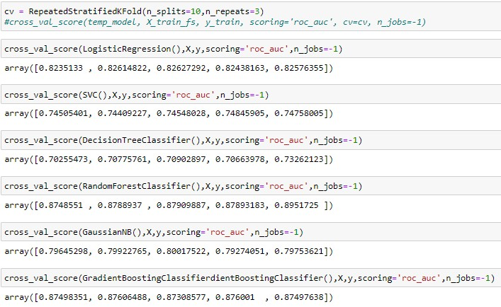
MODEL USED
We will use Random Forest Classifier as
the best algorithm as it is giving us the best results.
The metrics on which we have evaluated the model is AUC_ROC with 5 Folds and 3 Times repeated Stratified Cross Validation.
The Adjoining figure shows us all the
models used for Experimentations .

Slide 12
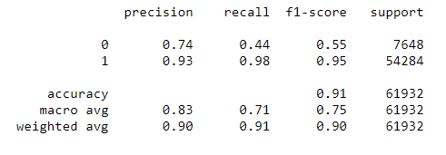
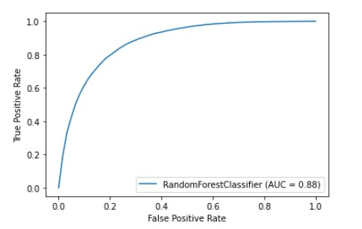
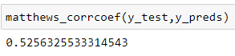
EVALUATION RESULTS
Classification Report
ROC Curve
Matthew’s Correlation Coefficient

Slide 13

THANK YOU
Prathamesh Mistry
+91 8450905341
mistryprathamesh@gmail.com
www.linkedin.com/in/prathamesh-mistry-a111071b4

